Slide 1


Rôles de Wnts et MuSK, Un récepteur tyrosine kinase dans le cerveau.
Projet de Stage
M2 Neurosciences
Florent KLEE
Supervisé par Claire LEGAY
CNRS – UMR 8119
Université Paris Descartes
M2 Neurosciences
Année 2017/2018

Slide 2
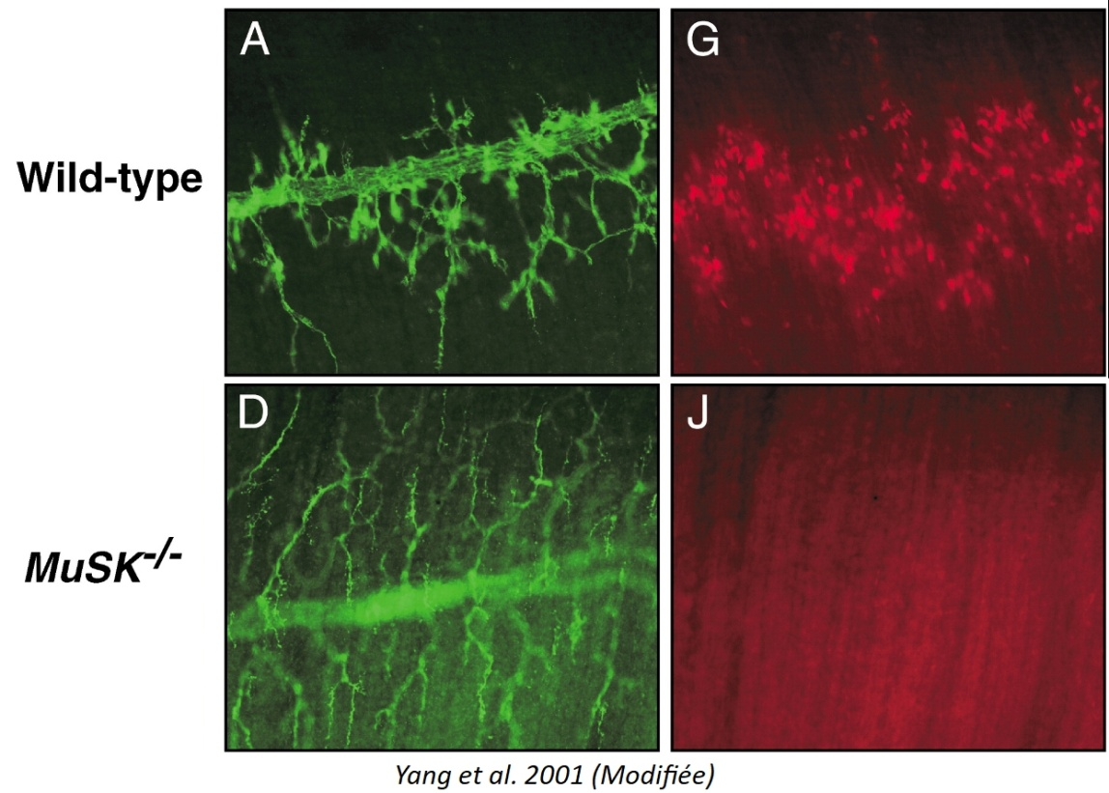
MuSK at the NMJ
NF AChR
Localized at Neuromuscular Junction on the muscle side with its co-receptor LRP4 ;
Master organiser of post-synaptic development at the NMJ ;
Determines the position of the synapse ;
Attracts the axon terminal ;
Initiates and maitains AChR aggregation ;

Slide 3
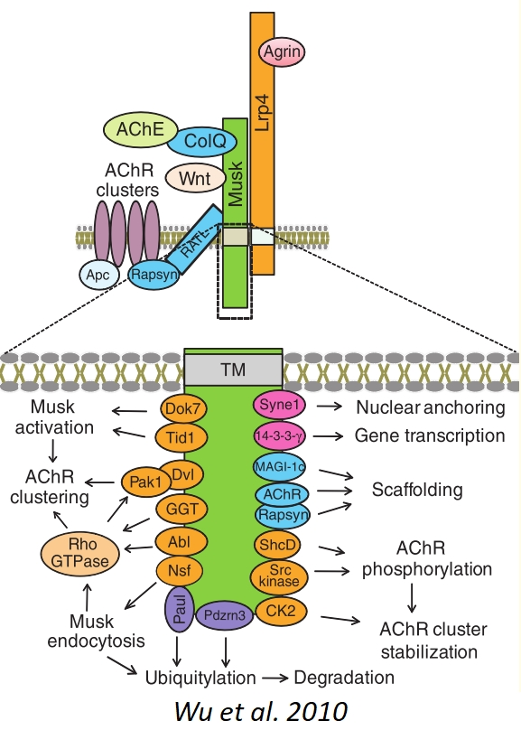
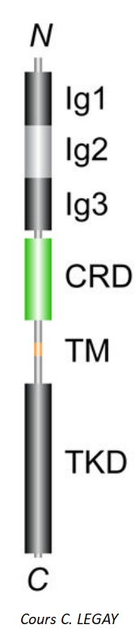
MuSK Receptor
Tyrosine-Kinase Receptor ;
5 conserved domains : 3 Ig-like domains, 1 Frizzled-like domain (CRD), 1 Kinase domain ;
Differents ligands : Agrin, ColQ and Wnts proteins.

Slide 4
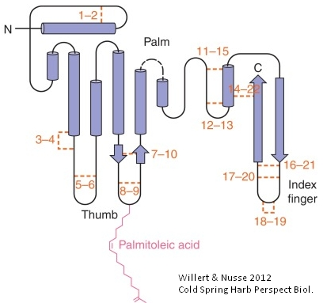
Wnt Proteins
Discovered in 1982 in mice, already known as Wingless in D. melanogaster;
Interact with Frizzled Receptor ;
19 coding genes for Wnts proteins and high post-translational diversity ;
Signaling molecules that influence myriad of biological and developmental processes ;
Three mains pathways : Canonical pathway, PCP pathway and Wnt/Calcium pathway ;
Seem to regulate pre- and post-synaptic differenciation ;
Can bind to MuSK receptor, especially Wnt4, 9a and 11 which stimulate AChR clustering ;

Slide 5
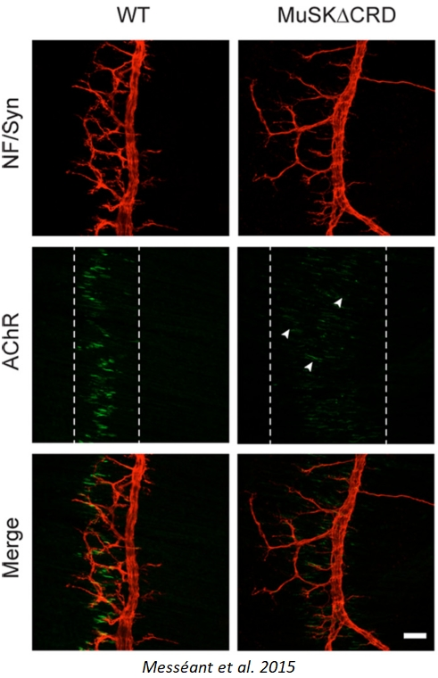
Testing MuSK as a receptor for Wnts
To analyse the CRD role, Claire Legay’s team has generated a MuSKΔCRD mouse (Messéant et al, J. Neurosci. 2015, Development 2017) ;
Increase of the neurite length, AChR cluster almost undetectable ;
Mice are myasthenics ;
LiCl treatment restores the phenotype to normal.

Slide 6
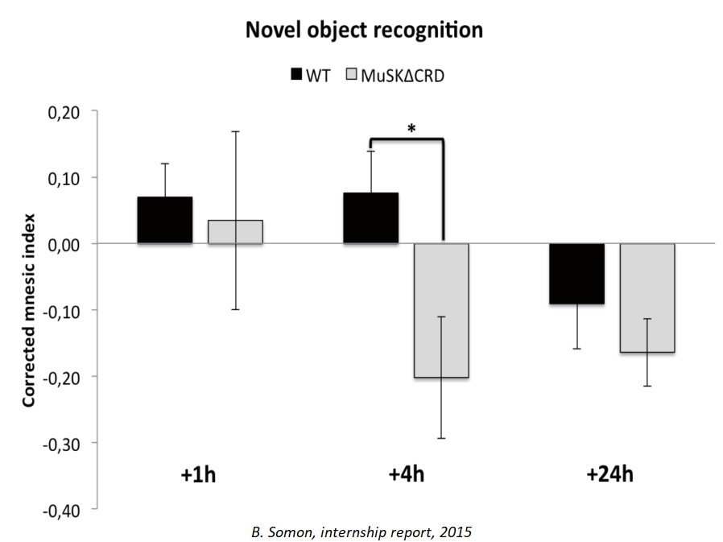
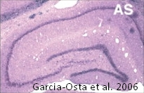
Central defects in MuSKΔCRD mutant
Mice show abnormal behaviour and injuries for the males ;
Another student showed that their is an intermediate-term memory alteration on mice ;
MuSK seems to be expressed mainly in the hippocampus in adult rats (Garcia-Osta et al. 2006).

Slide 7
Background on MuSK and Wnts in the Brain
Wnt proteins plays major roles in the brain such as axon guidance, consolidation of the synapse, induction of BDNF...
In the hippocampus, several roles : dendrites formation, increase of Glut response, increase of GABA receptor turn-over, help the formation of LTP...
MuSK and agrin seem to be implicated in memory formation and the LTP of the hippocampus ;
Little is know about the role of MuSK and Wnts in the brain.

Slide 8
Questions
La structure globale du cerveau est-elle affectée chez le mutant ?
Quelles sont les cellules exprimant MuSK/MuSKΔCRD ?
Quel est le niveau d’expression de MuSK et MuSKΔCRD dans le cerveau ?
(4. Quelle est l’origine des blessures observes chez le mutant mâle ?)

Slide 9
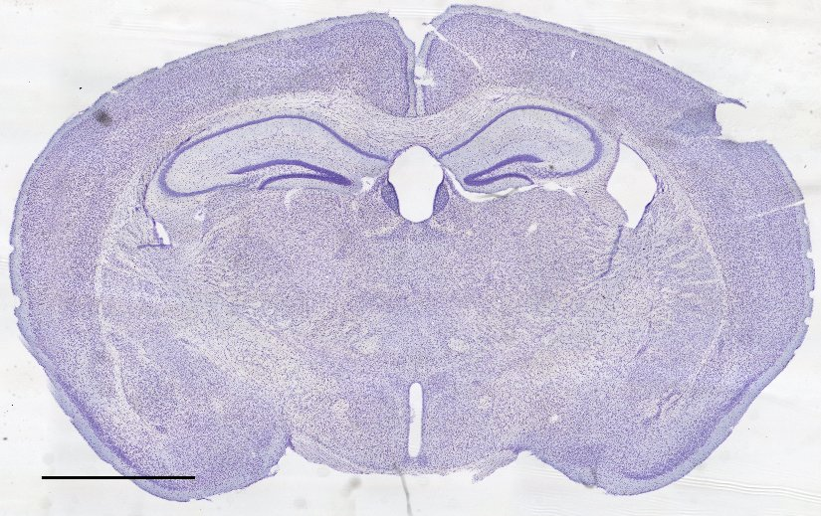
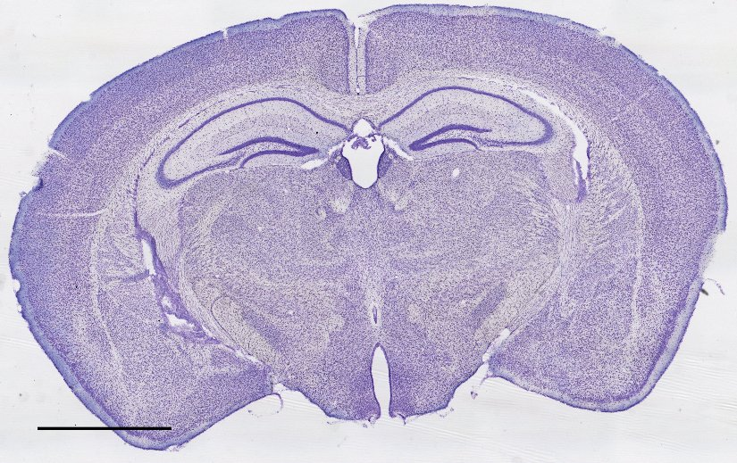
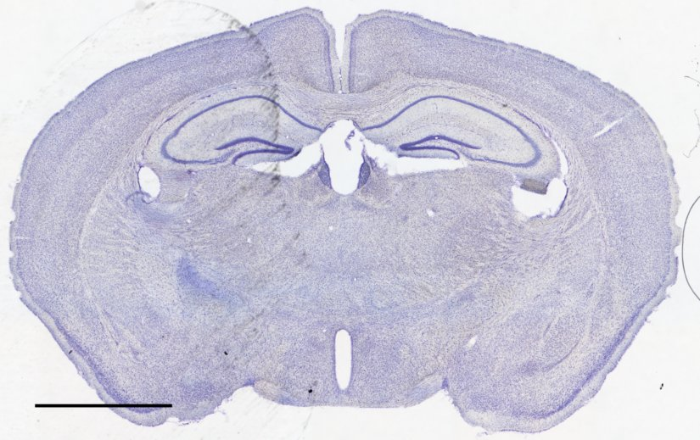
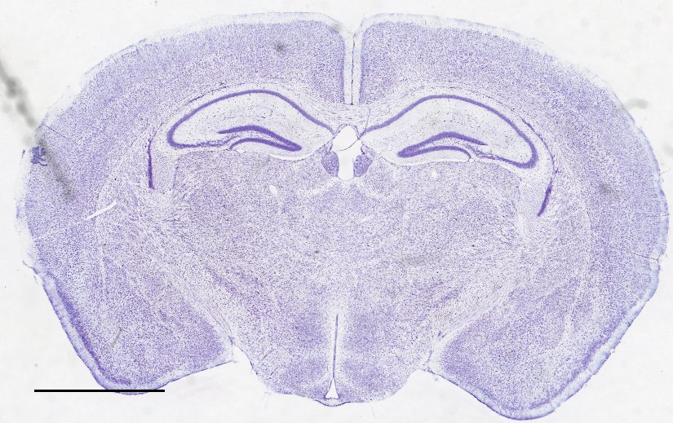
Structure du cerveau : Coloration de Nissl
WT
Mut
♀
♂
N = 4
Barre d’échelle : 2mm

Slide 10
Thanks for your attention !

Slide 11
Localisation of MuSK staining
Structure | Présence
DG | + | GCL/Hilus
CA1 | + | Stratum Oriens
CA3 | + | Stratum Oriens
Cortex | -
Corpus Callosum | + | Along the cells

Slide 12
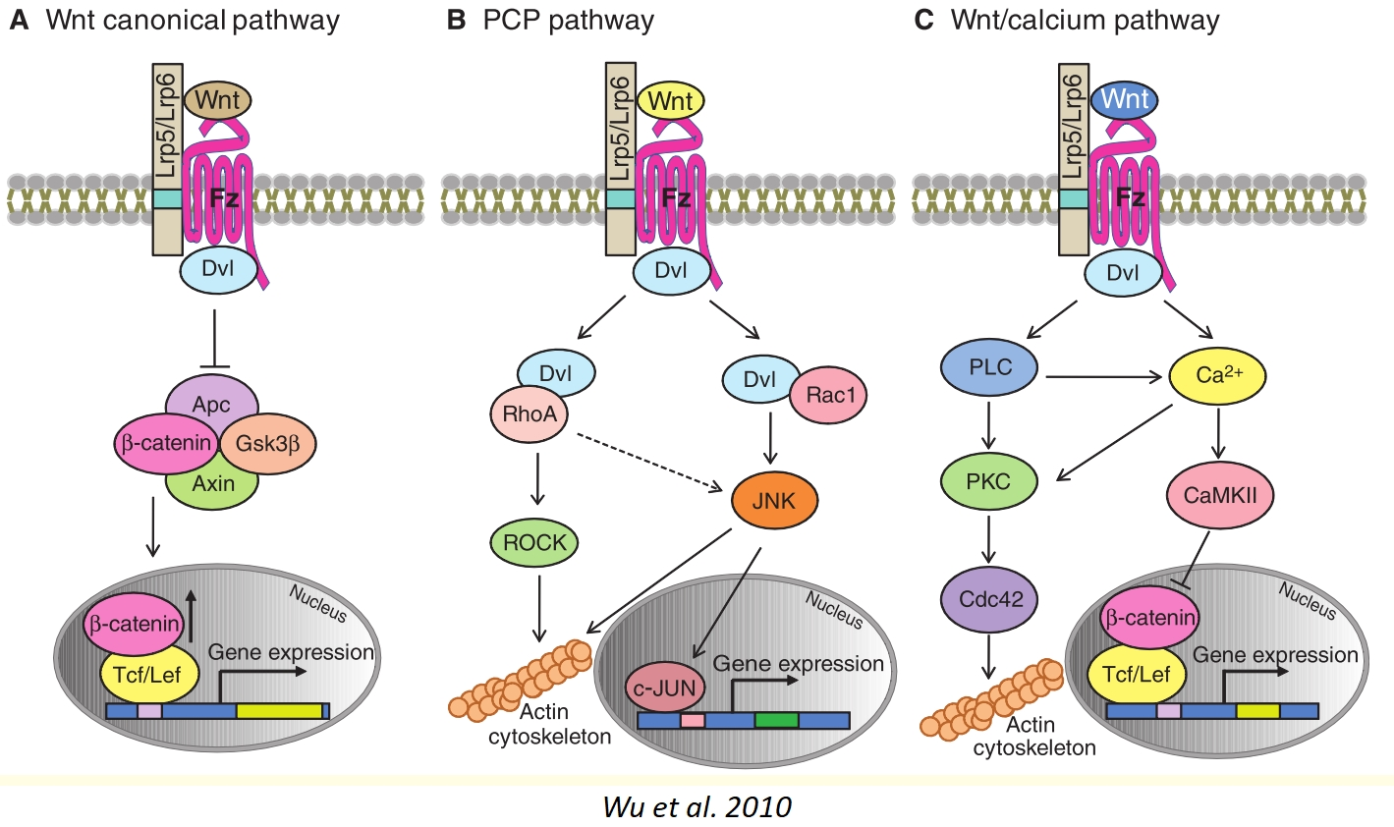
Wnt Proteins Pathways

